Slide 1



Lecture-1
C Advanced
C Preprocessors

Slide 2


C Preprocessors?

Slide 3
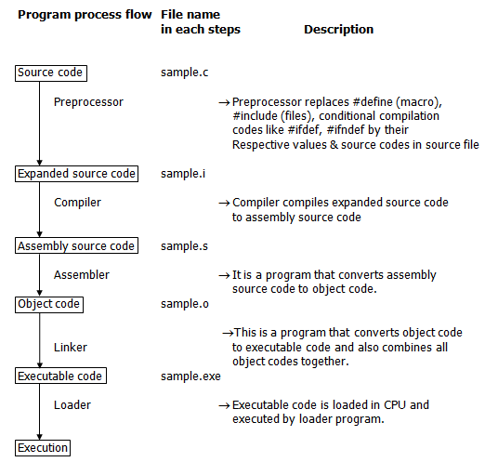
C Preprocessors?

Slide 4
Before that...
Header Files and macros?

Slide 5
Before that...
Header Files and macros?
Parameterized Macros?

Slide 6
C Preprocessors
Not a part of the compiler
Substitution of text
Done before actual compilation
Mostly used to import predefined functions and to create marcos

Slide 7
C Preprocessors
Not a part of the compiler
Substitution of text
Done before actual compilation
Mostly used to import predefined functions and to create marcos
Syntax:
Always begins with ‘#’

Slide 8
Preprocessor Directives:
#include : includes a file
syntax:
#include<file_name> - standard header file
OR
#include “file_name” - user-defined files

Slide 9
Preprocessor Directives:
#define : defines a macro
syntax:
#define macro_name(definition) macro_value

Slide 10
Preprocessor Directives:
#ifdef : include a block of code if a macro has been defined
#ifndef : include a block of code if a macro has not been defined
#endif : close off #ifdef, #if, and #ifndef
syntax:
#ifdef macro_name
code
#endif

Slide 11
Preprocessor Directives:
#if : checks condition
#else : when “#if” fails
defined() : checks if a macro has been defined or not -> can be compounded
syntax:
#if condition
preprocessing instructions
#else
preprocessing instructions
#endif

Slide 12
Preprocessor Directives:
#undef : remove a marco
syntax:
#undef macro_name

Slide 13
Preprocessor Directives:
#error : prints error message if encountered by compiler and stops further compilation
#pragma : compiler specific, runs function before or after main() is executed
syntax:
#pragma startup function_name
#pragma exit function_name

Slide 14
Preprocessor Operators:
Continuation Operator ‘\’: to continue a macro in next line
Defined() Operator: checks whether an macro has been defined earlier or not
Stringize Operator ‘#’ : Converts macro argument to string
Example:
#define greet(p1, p2) \
printf(“Hello “ #p1 “ and “ #p2 “\n”)

Slide 15
Predefined Macros:
__Date__ : Current date as character literal [“MMM DD YYYY”]
__TIME__: Current time as character literal [“HH:MM:SS”]
__FILE__: Current time as string literal
__LINE__: Current line number as a decimal constant
__STDC__: Defined as 1 when system compiler uses ANSI standard
Note: gcc uses ANSI standards, some old compilers do not.

Slide 16
Thank You!

